Slide 1
Real vs. Fake News Analysis
Semantic Analysis Project
Presented by [GROUP - 1]
KUNJA RAHUL DEEP
MUHAMED YASIN
S PREETHAM
JOSHI KUNAL ASHOKBHAI
BANGARI SHANMUKH

Slide 2
Introduction
🔹 Fake news detection is crucial in today's digital world.
🔹 This project classifies news articles as real or fake using machine learning.
🔹 Dataset: 40,000 articles (20,000 real, 20,000 fake).

Slide 3
Business Objective
🎯 Accurately classify fake and real news articles.
🎯 Use Natural Language Processing (NLP) and Machine Learning.
🎯 Deploy a user-friendly web interface for easy classification.

Slide 4
Dataset Details
📌 40,000 articles (20,000 real, 20,000 fake)
📌 Text-based dataset requiring preprocessing
📌 Techniques used: Tokenization, Stopword Removal, Vectorization

Slide 5
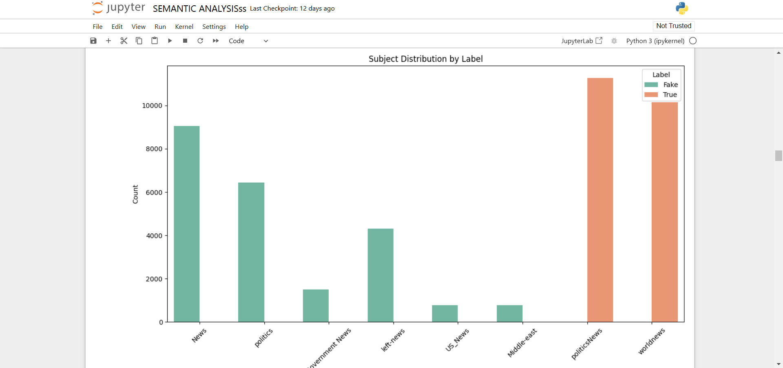

Slide 6
Methodology
🛠 Steps followed:
✔ Data Cleaning & Preprocessing
✔ Feature Engineering (TF-IDF, Word Embeddings)
✔ Sentiment Analysis & N-gram Analysis
✔ Model Training & Evaluation
✔ Deployment using Flask/Streamlit

Slide 7
Confusion Matrix - Model Performance
✅ Visual representation of model predictions vs actual labels.
✅ Helps measure True Positives, False Positives, etc.
✅ Accuracy, Precision, and Recall scores analyzed.

Slide 8
Word Cloud - Real vs Fake News
✅ Real news: Common words include ‘verified’, ‘confirmed’, ‘official’.
✅ Fake news: Words like ‘hoax’, ‘misleading’, ‘clickbait’ appear frequently.
✅ Provides insight into distinguishing words.

Slide 9
Sentiment Analysis & N-gram Trends
📊 Sentiment Distribution:
✔ Positive News: 30%
✔ Neutral News: 50%
✔ Negative News: 20%
📊 Common N-grams:
✔ 'Breaking News', 'According to reports', 'Fake Report'

Slide 10
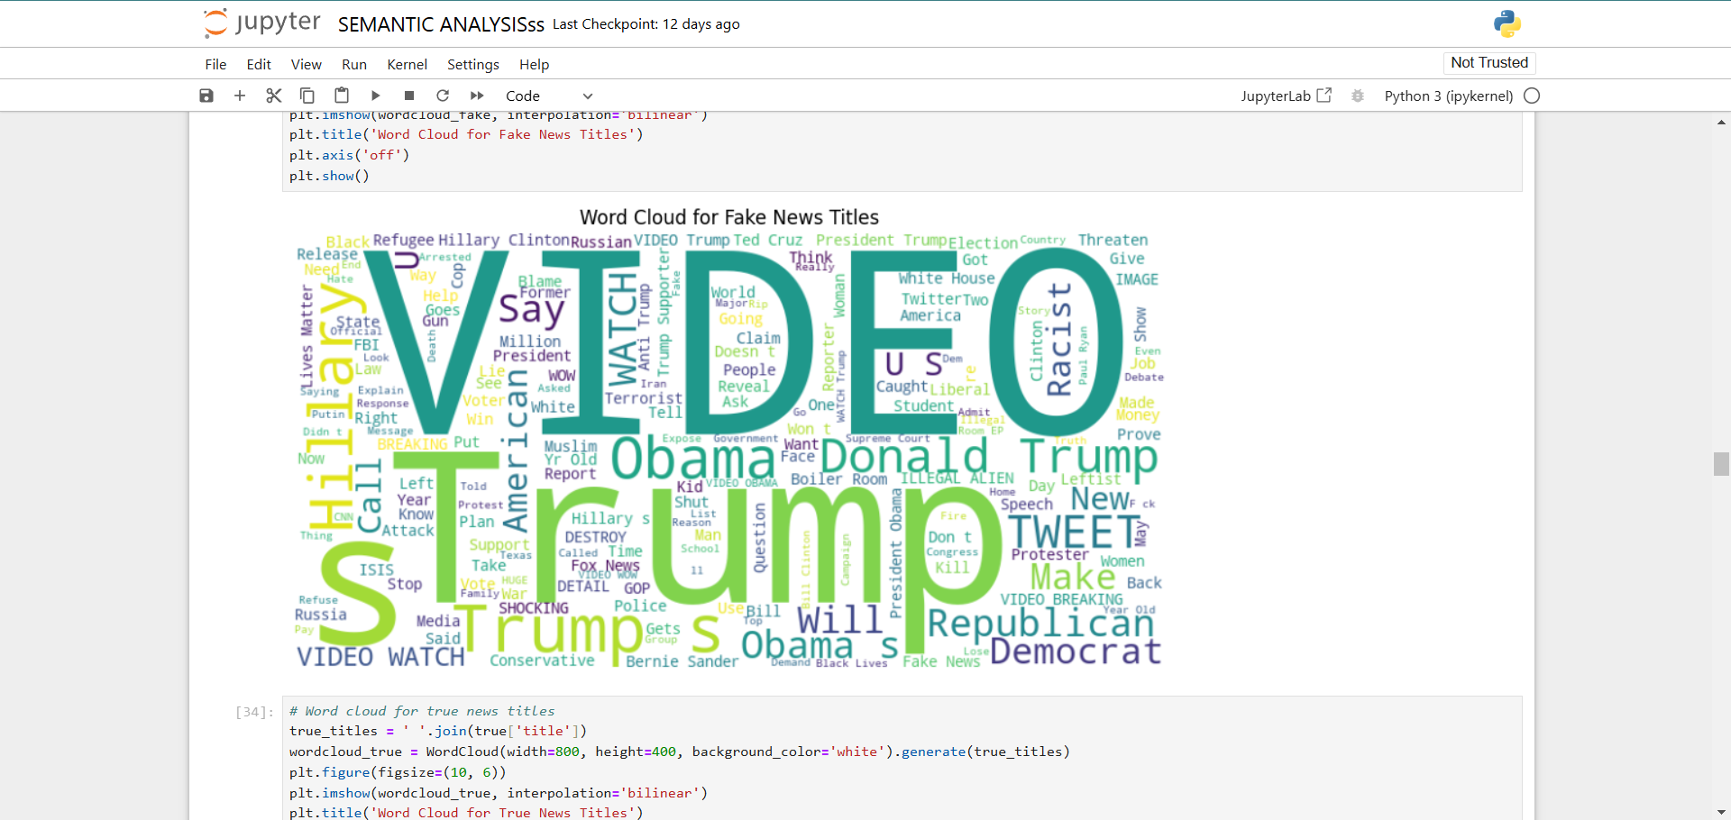

Slide 11
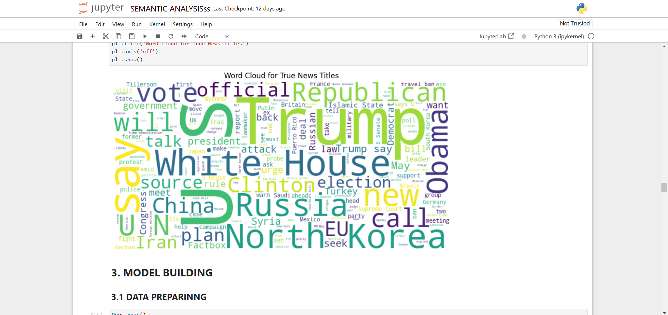

Slide 12
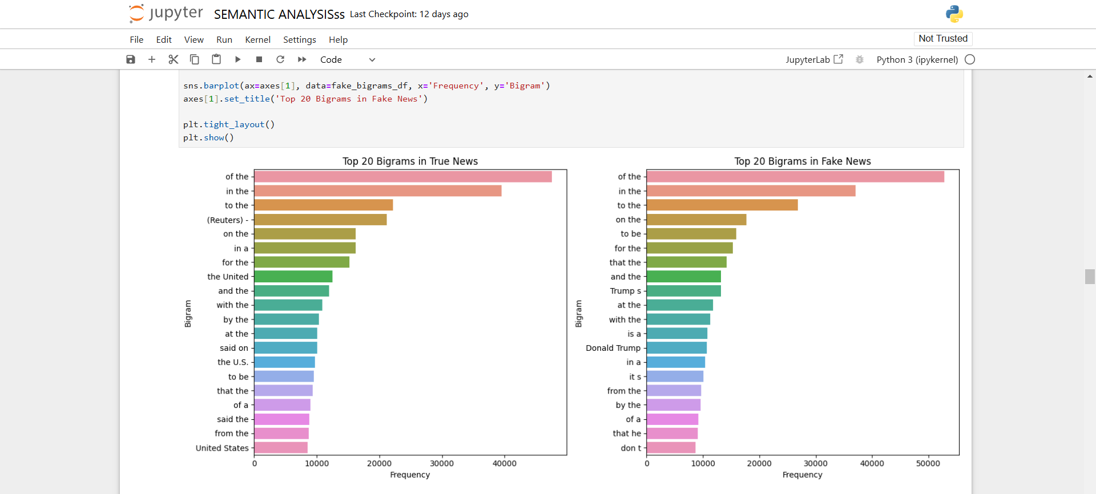

Slide 13
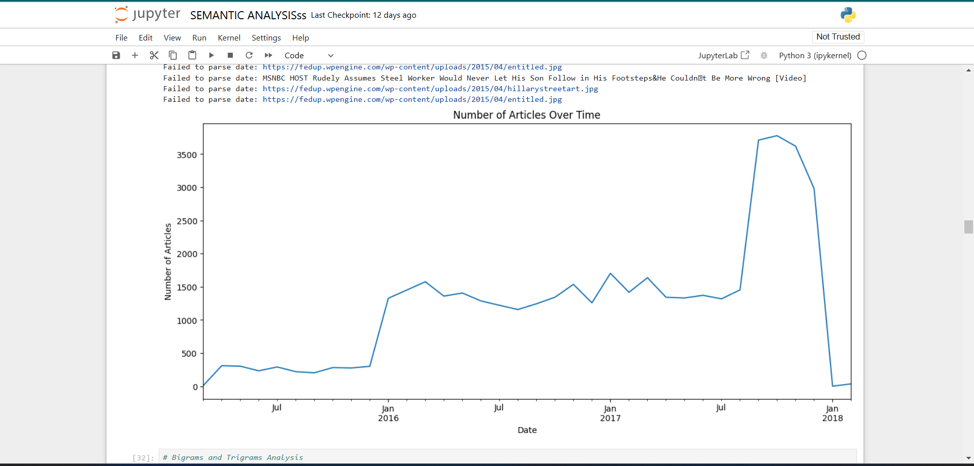

Slide 14
Model Performance Metrics
✔ Best Model: XgBoost (Accuracy: 99.2%)
✔ Precision & Recall values for Fake vs Real News
✔ Hyperparameter tuning for better efficiency.

Slide 15
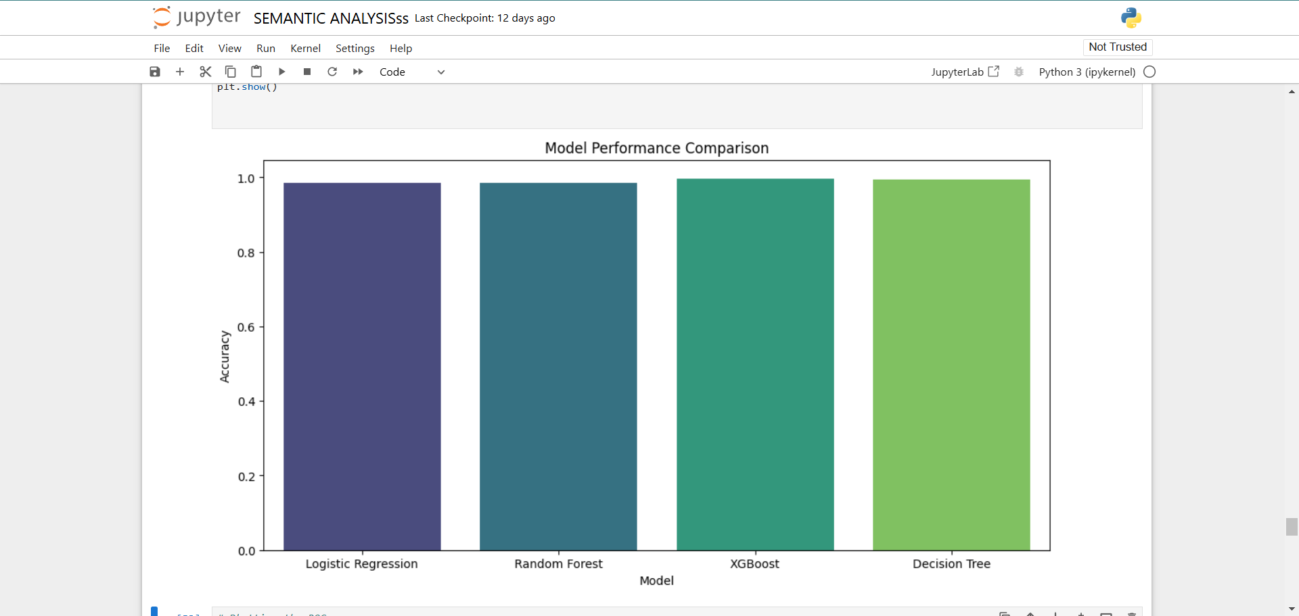

Slide 16
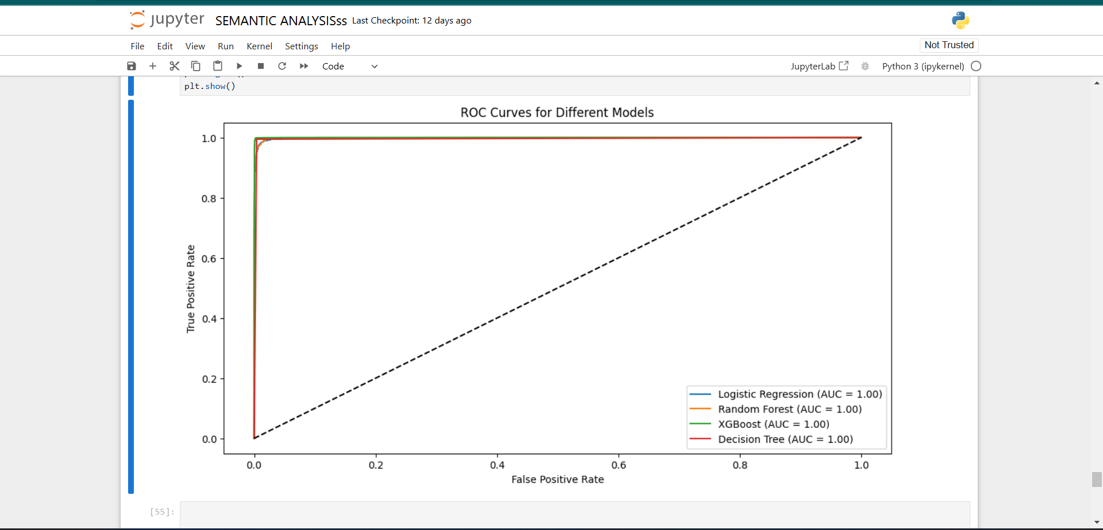

Slide 17
User Interface - Web Deployment
📌 Developed using Flask/Streamlit.
📌 Users can enter a news article & get predictions.
📌 Displays prediction confidence & explanation.

Slide 18
Conclusion & Future Enhancements
✔ Successfully classified Real vs Fake News.
✔ Future scope:
🔹 Advanced Deep Learning (Transformers, BERT)
🔹 Real-time scraping & detection
🔹 Multi-language support

